Slide 1
ParseNet: Looking Wider to See Better
Wei Liu, Andrew Rabinovich, Alexander C. Berg
ICLR 2016 submission
Computer Vision and Pattern Recognition (cs.CV)
二資工四 A10515003 鄧鵬宇

Slide 2
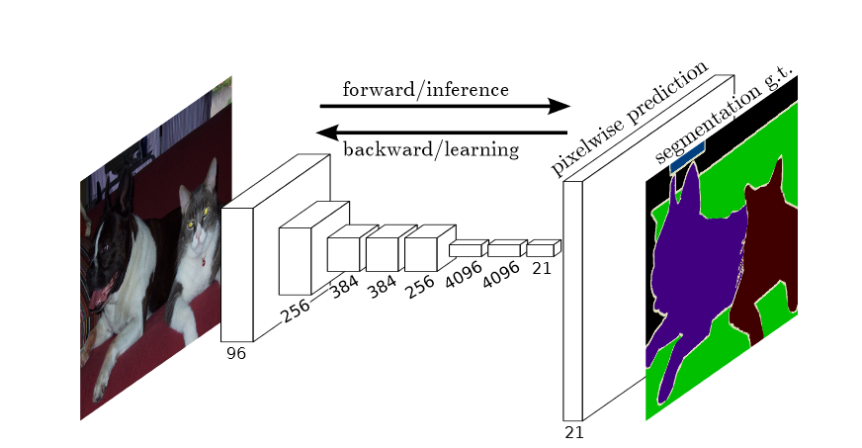
Fully Convolutional Networks
全卷積網路(FCN)的結構示意圖

Slide 3
Pooling
上圖顯示池化如何應用於一個圖像的四塊不重合區域。

Slide 4
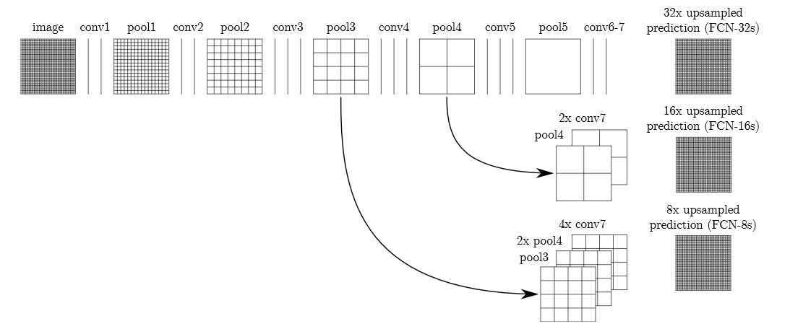
FCN UPSAMPLE
单击此处编辑母版文本样式
第二级
第三级
第四级
第五级

Slide 5
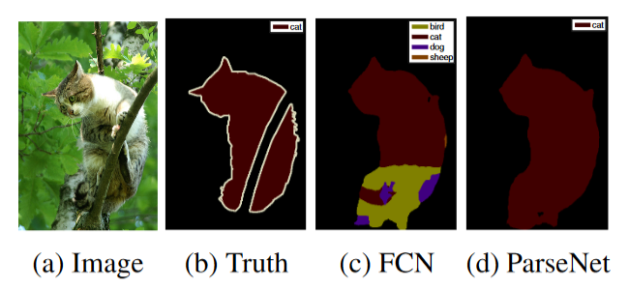
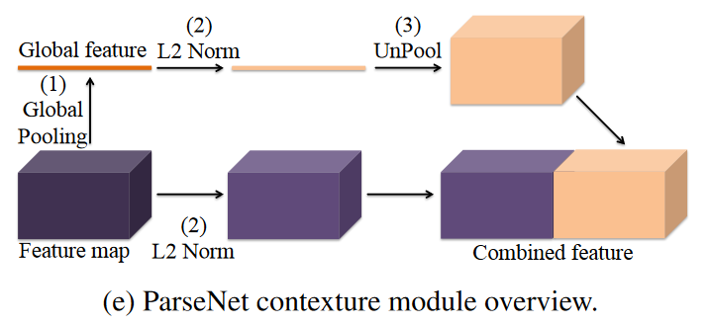
Global Context

Slide 6
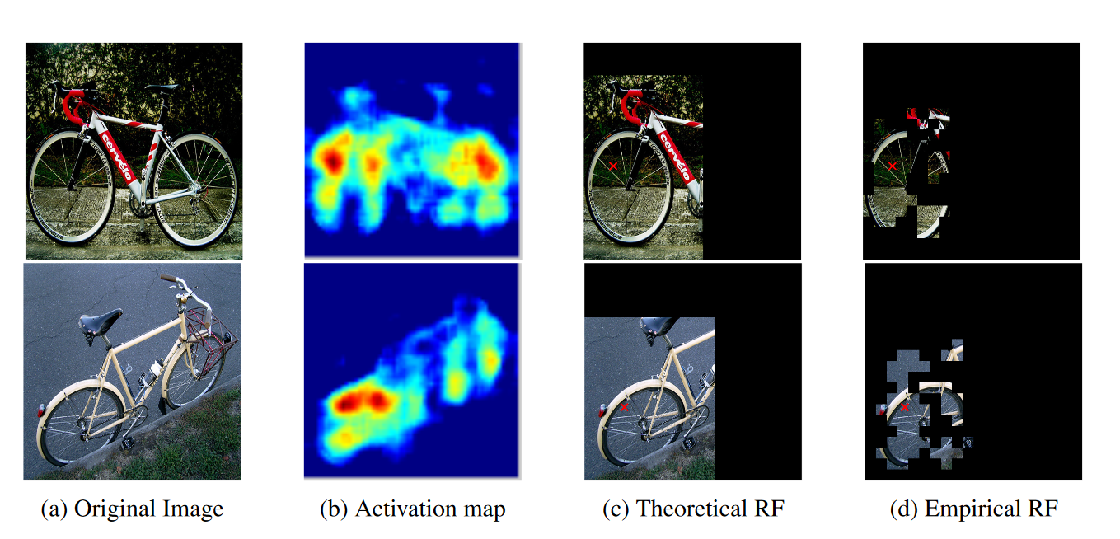
Receptive Field

Slide 7
Global Context = Looking Wider

Slide 8
Experiments
VOC2012
PASCAL-Context
SiftFlow

Slide 9
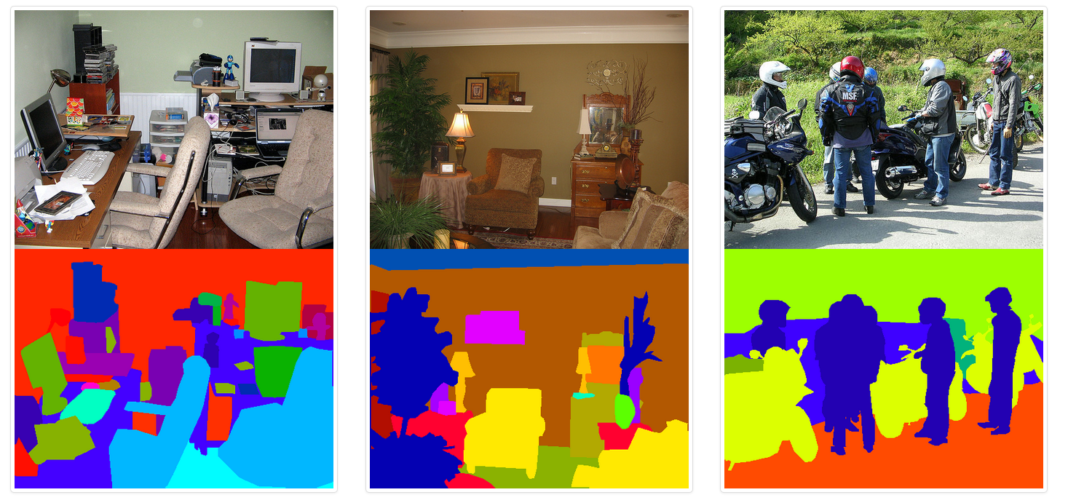
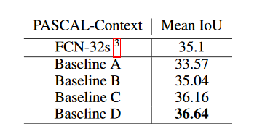
PASCAL Context dataset

Slide 10
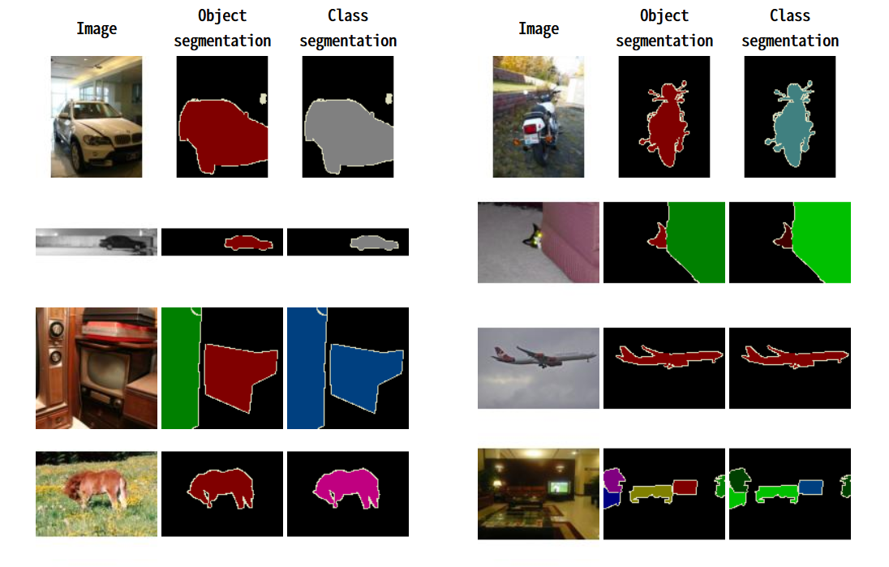
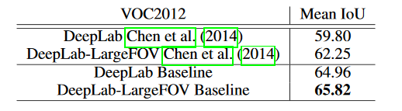
PASCAL VOC 2012 dataset

Slide 11
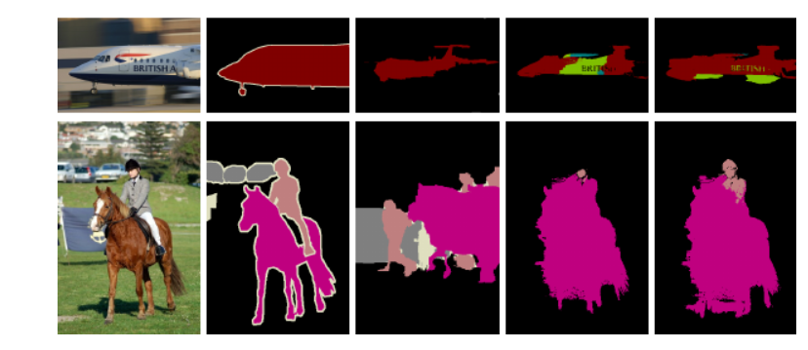
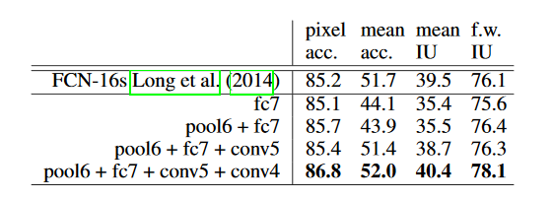
SiftFlow dataset

Slide 12
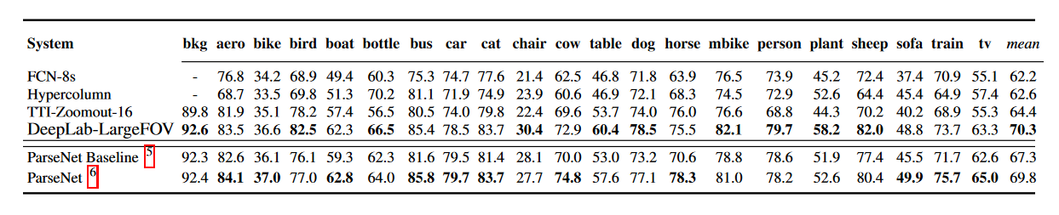
result

Slide 13
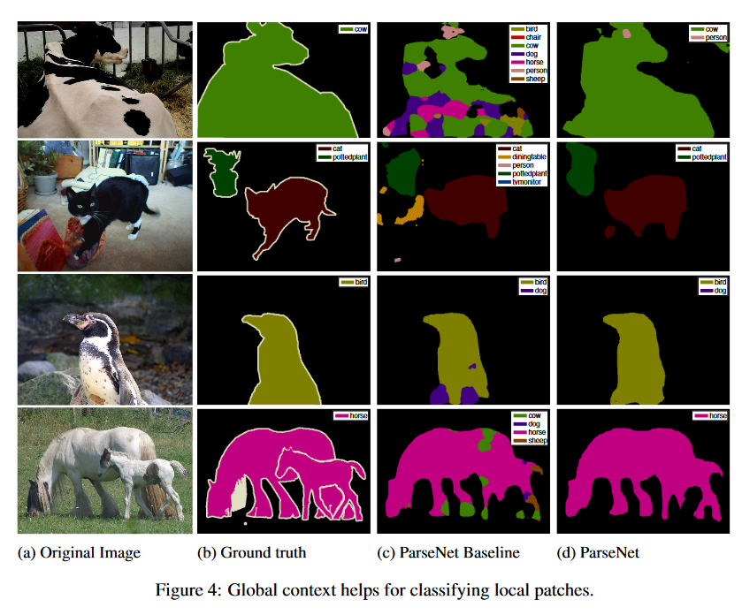
Global Context helps for classifying local patches

Slide 14
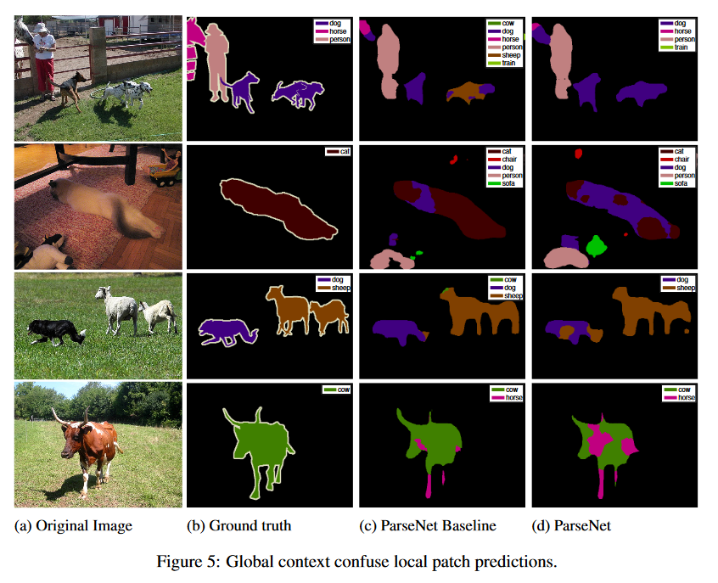
Global Context confuse local patch predictions

Slide 15
Conclusion

Slide 16
参考资料
Fully Convolutional Networks for Semantic Segmentation（ Computer Vision and Pattern Recognition (CVPR), 2015 IEEE Conference on）
http://ufldl.stanford.edu/wiki/index.php/Pooling
http://host.robots.ox.ac.uk/pascal/VOC/voc2012/

